Slide 2
Temporal Difference
Temporal Difference (TD) learning is a fundamental concept in reinforcement learning (RL) that plays a crucial role in various RL algorithms, including Q-learning, SARSA (State-Action-Reward-State-Action), and TD(λ) methods.
TD learning focuses on estimating the expected cumulative future rewards, also known as the value function, by iteratively updating the value estimates based on the observed rewards and predictions.
Temporal Difference Error (TD Error):
The TD error is a key element in TD learning. It's the difference between the predicted value of a state (or state-action pair) and the actual observed reward plus the estimated value of the next state. The TD error for a state s is given by:
TD(s)=R + γ⋅ V(s′)−V(s), or TD(s) = R_{t+1} + γ . V(S_{t+1}) –V(S)
where R is the immediate reward, γ is the discount factor, ′s′ is the next state, V(s) is the predicted value of state s, and V(s′) is the predicted value of the next state.

Slide 3
Value Function Update:
TD learning updates the value function (e.g., Q-values in Q-learning) based on the TD error. The update rule typically involves adjusting the current value towards the TD target: V(s)←V(s)+α⋅TD(s), where α is the learning rate.
TD Learning in Q-Learning:
In Q-learning, the Q-value of a state-action pair Q(s,a)) is updated using the TD error: Q(s,a)←Q(s,a)+α⋅(R+γ⋅maxa′​Q(s′,a′)−Q(s,a)).
This update helps the Q-value approximation converge towards the true Q-values.

Slide 4
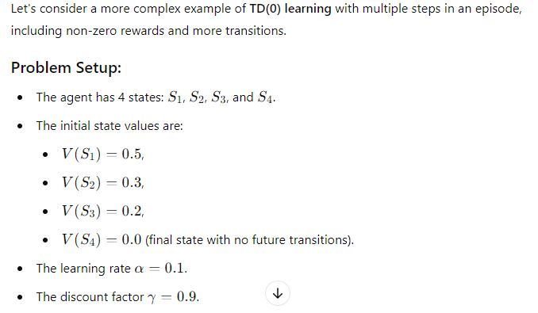

Slide 5
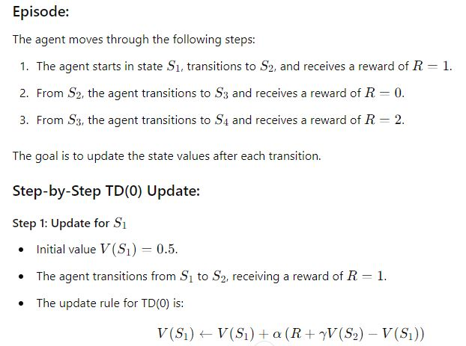

Slide 6
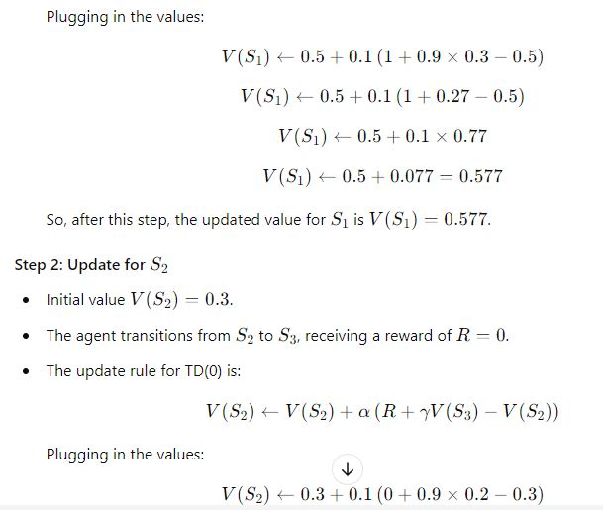

Slide 7
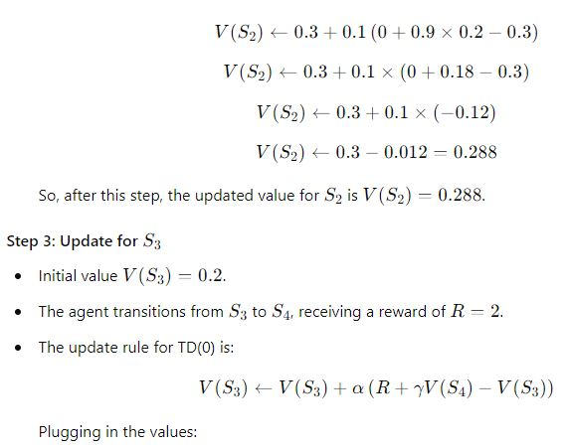

Slide 8
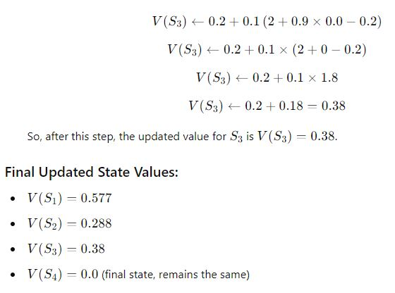

Slide 9
Limitations of Q-Learning
High-Dimensional State Spaces:
Q-learning struggles to handle high-dimensional state spaces effectively, such as those encountered in computer vision or natural language processing tasks. The state-action space can become excessively large, making it challenging to store and update Q-values efficiently.
Curse of Dimensionality:
Q-learning's reliance on a table to store Q-values becomes impractical as the state space grows exponentially with the number of dimensions. This course of dimensionality leads to a combinatorial explosion in the memory and computational requirements, rendering the approach unfeasible for many real-world problems.
Continuous Action Spaces: Standard Q-learning is not designed for environments with continuous action spaces (exp. Controlling a robotic arm, an agent might take an angle between 0 to 180, while in discrete only few angle are available.. While adaptations like deep Q-networks (DQNs) can handle this limitation by approximating Q-values with neural networks, basic Q-learning cannot.
Action Representation: Even in environments with many discrete actions, the representation might require complex handling that increases computational costs.
Exploration-Exploitation Trade-off:
Balancing exploration (to discover new actions) and exploitation (to choose the best-known actions) is a challenge in Q-learning. Traditional ε-greedy strategies for exploration can be inefficient, leading to suboptimal policies.

Slide 10
Convergence and Learning Rate Sensitivity:
The convergence of Q-learning is not guaranteed, especially in non-stationary environments. The choice of learning rate is crucial, and an inappropriate learning rate can lead to instability or slow convergence.
Delayed Rewards and Non-Markovian Rewards:
Q-learning assumes that the current state fully encapsulates all information needed to make decisions. However, in some environments, rewards may be delayed or non-Markovian (where rewards not only depends on current state, action but also depends on prior history of state, action and events), violating this assumption and making it difficult for Q-learning to learn an optimal policy.
Overestimation of Q-values:
Q-learning, especially in conjunction with function approximation like neural networks, can lead to overestimation of Q-values, which affects the quality of the learned policy. Techniques like Double Q-learning have been introduced to address this issue.
Sample Inefficiency:
Q-learning often requires a large number of samples to converge to an optimal policy. This sample inefficiency is a significant drawback, especially in domains where obtaining real-world samples is costly or time-consuming.

Slide 11
Inability to Handle Stochastic Environments Effectively:
In stochastic environments, where actions do not deterministically lead to specific states or rewards, Q-learning's deterministic nature can lead to suboptimal policies.
Knowledge of Environment Dynamics:
Q-learning typically assumes knowledge of the environment's dynamics, including transition probabilities and rewards. In practice, these dynamics may be unknown or difficult to model accurately.

Slide 12
Algorithm Refinement- Improved Neural Network Architecture
In Q-learning, using an improved neural network architecture can enhance the algorithm's performance and learning efficiency.
A well-designed neural network can help approximate the Q-value function accurately, leading to more effective and faster convergence.
Below are steps to incorporate an improved neural network architecture into the Q-learning algorithm:
Deep Q-Network (DQN) Architecture:
Utilize a deep neural network, often with convolutional layers, to approximate the Q-value function. The architecture should be designed to process state representations efficiently, especially for image-based input.
Convolutional Layers:
Incorporate convolutional layers to capture spatial patterns and features from the input states effectively, especially when dealing with image-based inputs. Convolutional layers can significantly improve the representation of visual information.

Slide 13
Dueling Network Architecture:
Implement the dueling network architecture, which separates the value function and advantage function (advantages of actions). This architecture allows for more stable and efficient learning by independently estimating the value of each state and the advantage of each action.
Advanced Activation Functions:
Experiment with advanced activation functions, such as Rectified Linear Unit (ReLU) variants, Leaky ReLU, Parametric ReLU (PReLU), or Exponential Linear Unit (ELU). These activations can help with faster convergence and mitigate vanishing gradient problems.
Batch Normalization:
Incorporate batch normalization layers to stabilize and accelerate the training process by normalizing the activations within each mini-batch. This helps improve convergence and generalization.
Dropout or Regularization:
Apply dropout or other regularization techniques to prevent overfitting and encourage the network to learn more robust features. Dropout can be applied to hidden layers to randomly drop out a fraction of neurons during training.

Slide 14
Residual Connections:
Implement residual connections to facilitate the training of very deep networks, ensuring effective gradient flow and easing the optimization process.
Use of Memory Buffers:
Integrate experience replay and target network updates, as commonly seen in DQN. It helps the agent store and reuse past experiences to improve sample efficiency and break the temporal correlations between consecutive samples. These techniques help stabilize learning and make the neural network training more efficient.
Learning Rate Scheduling:
Employ learning rate schedules, such as exponential decay or step decay, to adjust the learning rate during training. This can help in better convergence and prevent overshooting.

Slide 15
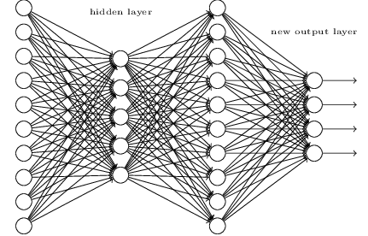
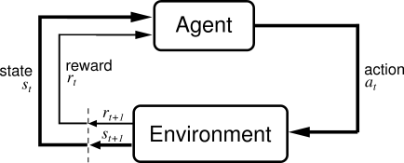
Deep Q Networks (DQN)
Deep Q-Networks (DQNs) are a class of deep neural network architectures used in reinforcement learning (RL), specifically in the context of Q-learning.
DQNs combine Q-learning, which is a value-based RL method, with deep neural networks to handle high-dimensional state spaces and complex tasks.
Neural Network Architecture:
DQNs utilize a deep neural network, often with convolutional layers, to approximate the Q-value function. This allows them to handle high-dimensional inputs, such as images, effectively.

Slide 16
Target Network:
DQNs use two separate networks: the Q-network (online network) and a target network. The target network is a delayed copy of the Q-network, and its parameters are periodically updated to stabilize training and improve convergence. (updating q values at every step makes network unstable)
Loss Function:
The loss function used in DQNs is often the mean squared error between the predicted Q-values and the target Q-values. The target Q-values are computed using the Bellman equation and the target network.
ε-Greedy Exploration: (It is used to control the explo-exploit tradeoff)
DQNs typically use an ε-greedy strategy for exploration, where with probability ε, a random action is chosen, and with probability 1-ε, the action with the highest Q-value is selected.
Target Q-Value Computation:
The target Q-value for a state-action pair is calculated as the immediate reward plus the discounted maximum Q-value for the next state: Qtarget​(s,a)=R+γ⋅maxa′​Q(s′,a′),
where R is the immediate reward, γ is the discount factor, ′s′ is the next state, and ′a′ is the action in the next state.

Slide 17
Algorithm Refinement – ε greedy policy
The ε-greedy policy is a crucial component in Q-learning that balances exploration (trying new actions) and exploitation (choosing actions with the highest estimated value).
Refining the ε-greedy policy can significantly impact the learning process and the efficiency of the Q-learning algorithm.
Here are some refinements and strategies to improve the ε-greedy policy in Q-learning:
Decaying ε:
Start with a high exploration rate (ε) and gradually decrease it over time. This approach allows for more exploration in the early stages of learning and shifts towards more exploitation as the agent gains experience.
Annealing ε:
Instead of a predefined decay schedule, dynamically adjust ε based on a specific annealing function or schedule. Common annealing functions include linear annealing, exponential decay, or logarithmic decay.
Softmax Action Selection:
Use a softmax function to select actions based on the Q-values, rather than a deterministic greedy strategy. This provides a soft selection of actions, allowing for a smooth transition from exploration to exploitation.

Slide 18
Boltzmann Exploration:
Use a variant of softmax action selection, known as Boltzmann exploration. It introduces a temperature parameter that controls the level of exploration. Higher temperature values allow for more exploration, while lower values lead to more exploitation.
ε-First Strategy:
Initially, use a high ε to encourage exploration for a certain number of episodes or steps. After this initial phase, switch to a lower ε to prioritize exploitation.
Varying ε for Different States or Actions:
Instead of using a constant ε, vary ε based on the state or action being considered. For example, you could have different ε values for different regions of the state space or for different actions.
Adaptive ε Based on Uncertainty:
Adjust ε based on the uncertainty or confidence in the Q-value estimates. Higher uncertainty might lead to more exploration to gather additional information.

Slide 19
Differential ε for Important States:
Assign a higher ε for states or regions of the state space that are considered important or challenging, encouraging the agent to focus exploration in those areas.
Parameter Tuning for ε:
Experiment with different ε values and decay schedules to find the optimal combination for your specific problem. Parameter tuning (e.g., using grid search or automated approaches) can help identify the most effective ε strategy.
Adaptive ε for Episodic Tasks:
Modify ε at the beginning of each episode based on the episode number or any other relevant metric. This can allow for more exploration in early episodes.

Slide 20
Q learning refinement- mini batches and soft updates
Refining Q-learning by incorporating mini-batches and soft updates can significantly enhance learning stability, efficiency, and convergence.
Mini-Batch Training:
Instead of updating the Q-value estimates using a single sample (as in standard Q-learning), mini-batch training involves updating the Q-network parameters based on a small random subset (mini-batch) of experiences sampled from the replay buffer. This approach improves stability and efficiency by reducing the variance in the updates and allowing for more effective weight adjustments.
Implementation Steps for Mini-Batch Training:
Sample a mini-batch of experiences (state, action, reward, next state) from the replay buffer.
Compute the target Q-values for each experience in the mini-batch using the Bellman equation.
Compute the loss between the predicted Q-values and the target Q-values for the mini-batch.
Update the Q-network parameters by minimizing this loss using backpropagation.

Slide 21
Soft Target Network Updates:
In addition to mini-batch training, introducing a target network with soft parameter updates enhances Q-learning stability. Rather than copying the parameters directly from the Q-network to the target network periodically (as in standard Q-learning), soft updates involve blending the target network's parameters slowly over time.
Implementation Steps for Soft Target Network Updates:
Instead of copying the Q-network parameters to the target network, update the target network's parameters gradually using a fraction τ (blending factor)of the Q-network's parameters at each step.
Mathematically, for each weight w in the target network and Q-network, perform:
w_{target}​←τ⋅w_{q}​+(1−τ)⋅w_{target}​, where τ is a small value (e.g., 0.001 to 0.01).

Slide 22
Benefits and Advantages:
Mini-batch training reduces the noise in the parameter updates and leads to more stable learning by providing a smoother update trajectory.
Soft target network updates mitigate issues related to target value oscillations and divergence, leading to a more stable and efficient learning process.
Parameter Tuning:
Tune hyperparameters such as mini-batch size, learning rate, and soft update rate (τ) to achieve optimal performance and convergence speed.

